Slide 2
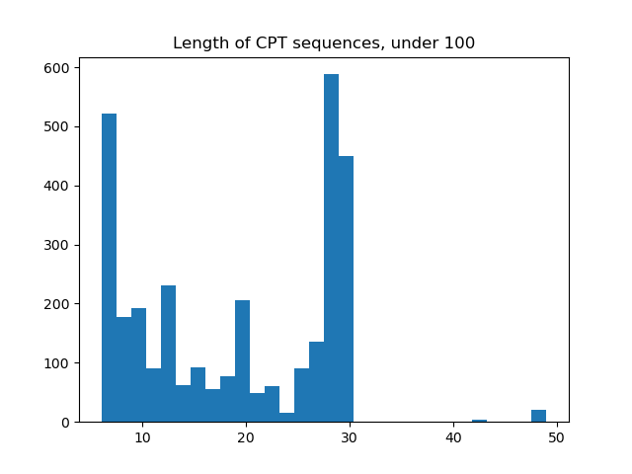
Piece sequence length
I need to cut these sequences of continuous cpt measurements into equal length pieces

